Slide 1



Arts 4 Wellbeing
HEALTH & Safety Induction

Slide 2


Visitors / MEMBERS
All visitors and members must ensure they sign in /out when entering or leaving Arts 4 Wellbeing.
Fire alarms will be tested every Friday by trained staff.
All visitors and members must ensure they know who their fire wardens and first aiders are on the day of their visit.
.

Slide 3
Emergency Action
Raise alarm, inform nearest member of staff.
Press Break Glass.
Evacuate the building.
Go to the assembly point, (playpark).
No person shall re-enter the building until informed it is safe to do so by a fire warden.

Slide 4

Fire wardens
  On the sounding of the fire alarm;-
  Fire Wardens will direct staff, members and visitors to the assembly point.
  Call the fire brigade.
  Trained Fire Wardens will sweep the building to ensure no person remains inside the building.
  Fire wardens can fight small fires, but must be done in pairs.

Slide 5
Fire wardens

Slide 6
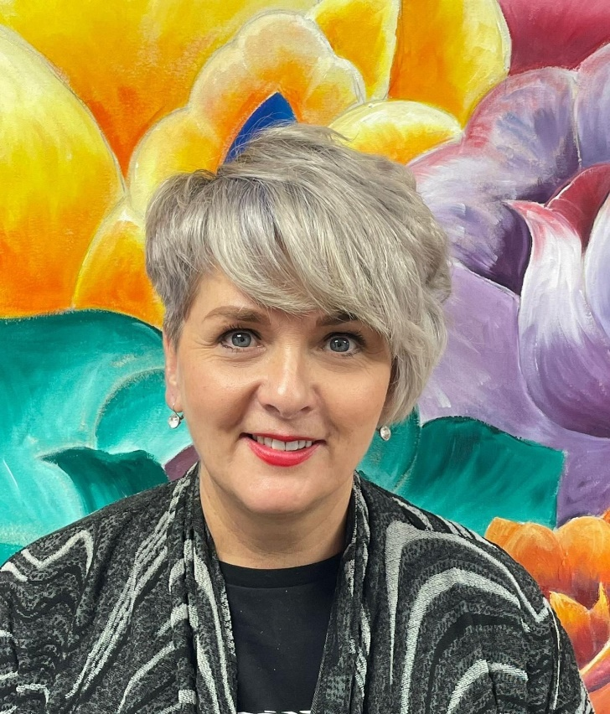
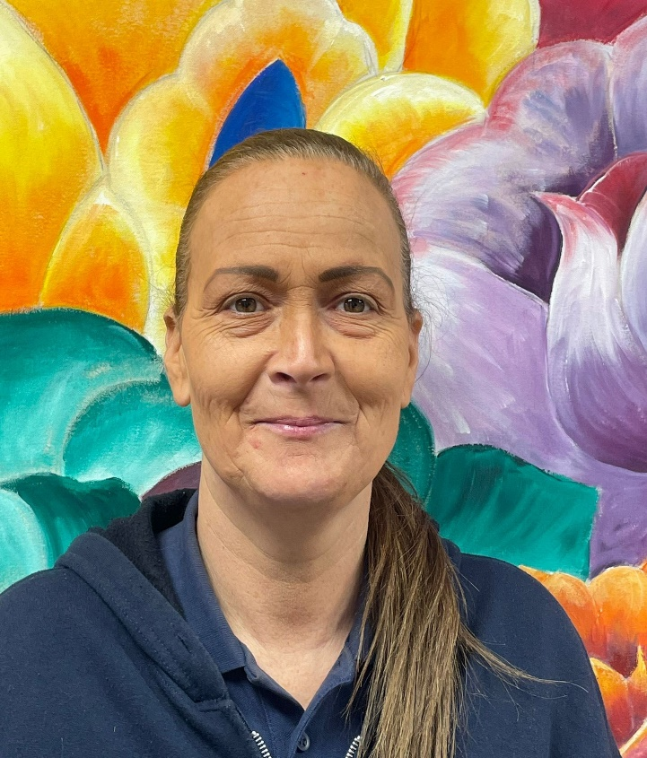
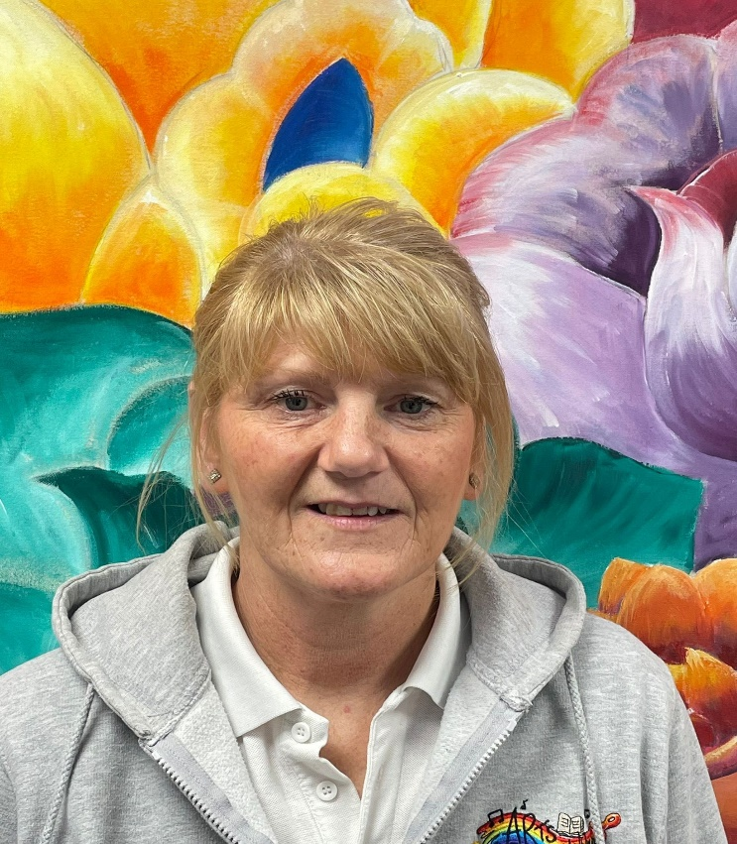
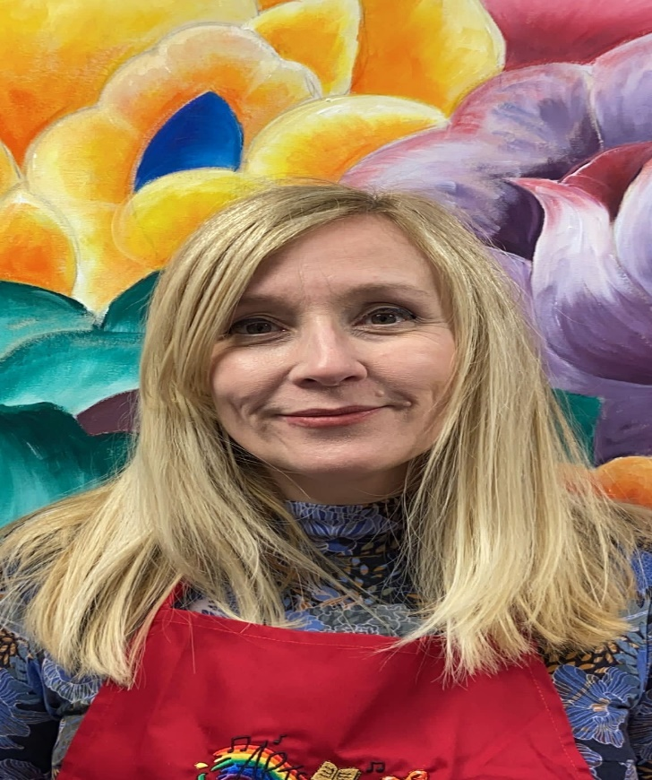
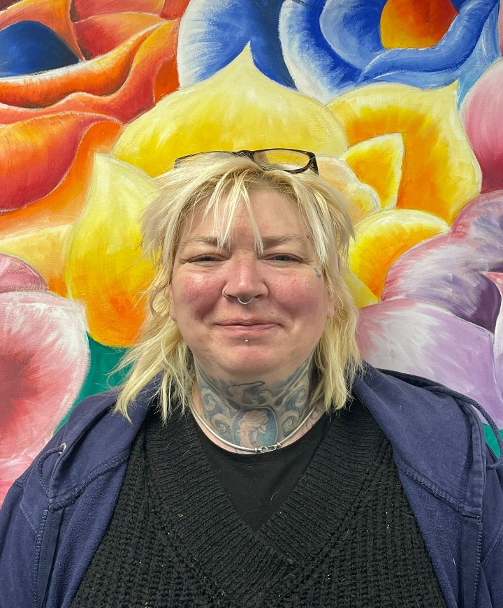
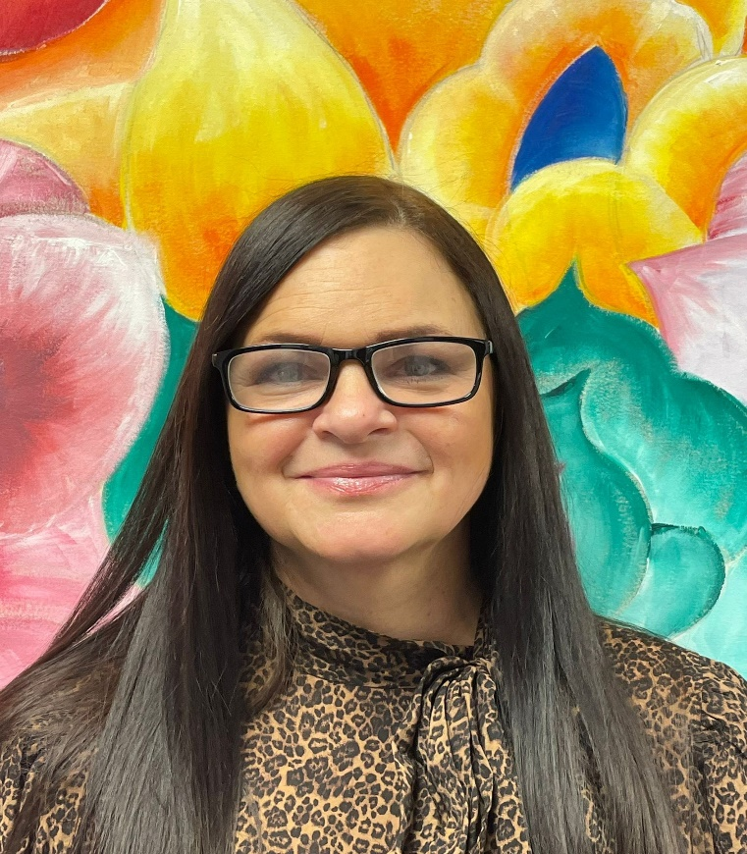
Fire wardens
Raylee Harrison
Julie Mooney
Beverley Taylor
Joanne Elliott
Fiona Hardy
Michelle Baker

Slide 7

First AIDERS
  Arts 4 Wellbeing have trained first aiders on site.
  If an incident occurs please ensure you inform a staff member who will ask for a first aider to attend.
  First aiders must ensure first aid supplies are always stocked up.

Slide 8
First Aiders responsibility
Manage the incident and ensure the continuing safety of themselves, bystanders and the casualty
Assess casualties and find out the nature & cause of their injuries
Arrange for further medical help or other emergency services to attend
If trained, priorities casualties based upon medical need
Provide appropriate first aid treatment as trained
If able, make notes/observations of casualties
Provide a handover when further medical help arrives
Fill out any paperwork as required

Slide 9

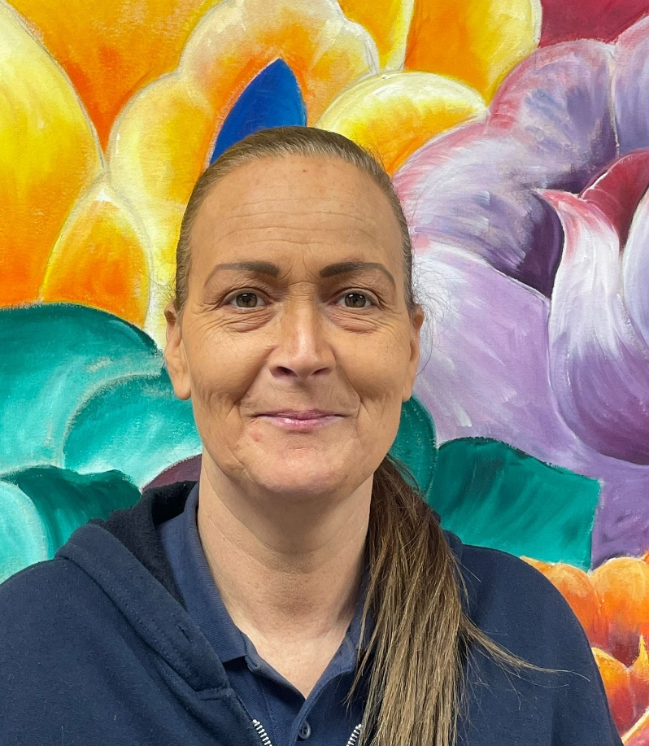
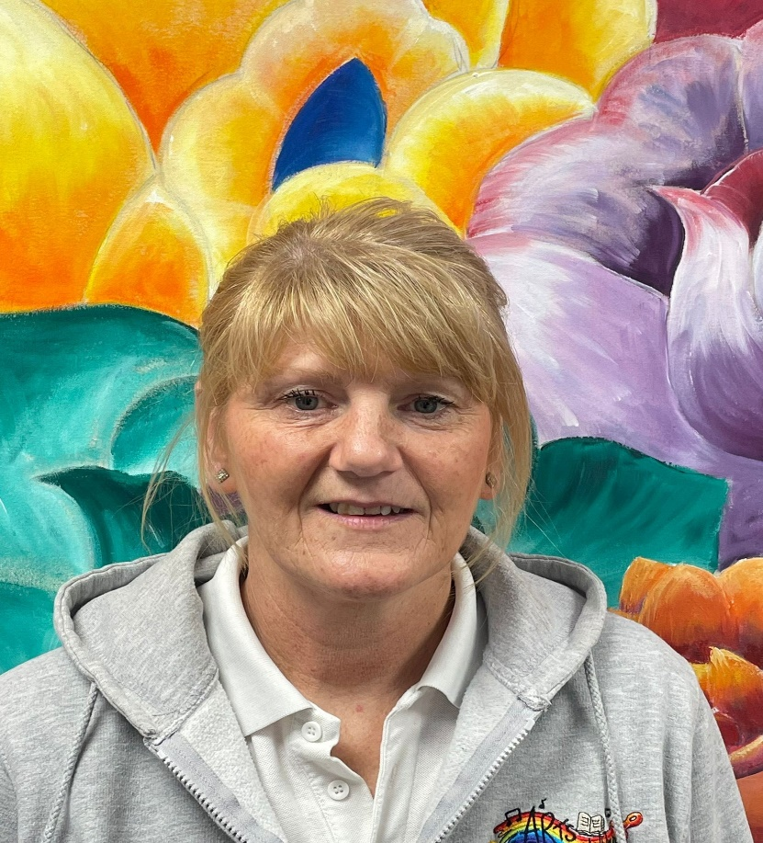
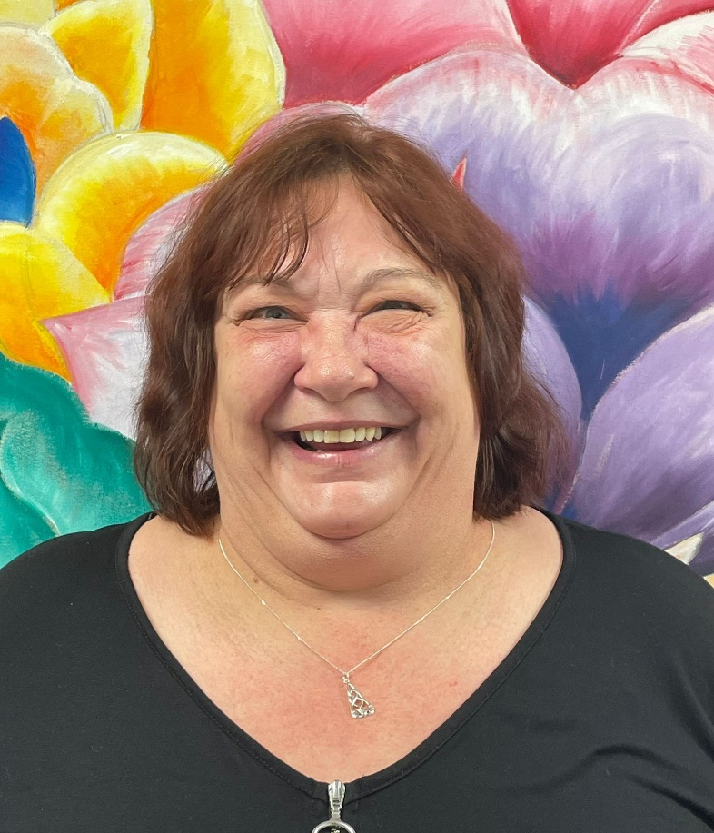



First AIDERS
Raylee Harrison
Julie Mooney
Beverley Taylor
Allison Tate
Joanne Elliott
Fiona Hardy
Michelle Baker

Slide 10

Mental Health First AIDERS
  Arts 4 Wellbeing have trained mental health first aiders on site.
  A point of contact for an employee or member who is experiencing a mental health issue or emotional distress
  Supporting the person to get appropriate help

Slide 11
Mental Health First Aiders responsibility
Manage the incident and ensure the continuing safety of themselves, bystanders and the casualty.
Maintain confidentiality(unless someone’s physical safety or life is at risk.
Spot early signs of mental ill-health.
Assess the risk of self-harm or suicide.
Listen to what people are saying without judgement.
Know when to contact the emergency services
(if it’s required).

Slide 12
Mental Health First AIDERS
Raylee Harrison
Beverley Taylor
Joanne Elliott
Michelle Baker

Slide 13




health advocates
The Better Health at Work Award is a recognised award that helps our organisation to move forward in a structured and supported way, promoting health at work and encouraging a healthy workforce.
Health Advocates are passionate about health and wellbeing at work.
Arts 4 Wellbeing promote healthy lifestyles and consider the health of their employees and service users.
Michelle Baker
Beverley Taylor
Joanne Elliott

